Slide 1
CSC103:
WELCOME TO PROGRAMMING FUNDAMENTALS
Abdul Karim Shahid
(akarim@ciitlahore.edu.pk)
Room C03

Slide 2
Outline
Slide <number>
1.1 Welcome to Programming Fundamentals
1.2 Why PF is important?
1.3 RoadMap
1.4 Text Book
1.5 Programming Fundamentals Labs
1.6 How to Succeed
1.7 How to Fail
1.8 Lectures and Lab
1.9 Ground Rules

Slide 3
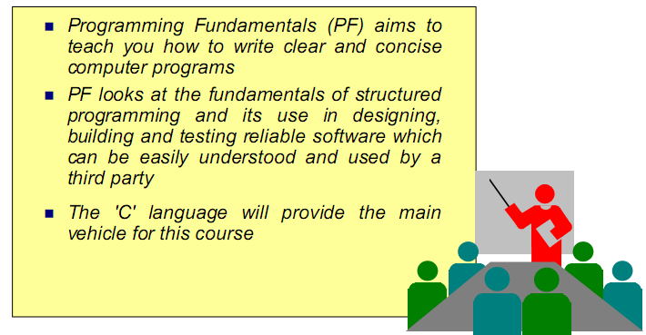
1.1 Welcome to Fundamentals of Computer Programming
Slide <number>

Slide 4
1.2 Why PF is Important?
Slide <number>
Intermix of Engineering and IT
  Today’s technology and solutions are becoming increasingly complex
  Engineers of major high technology industry (like manufacturing and communications) more and more need to have knowledge of network management, operating systems, internet, programming, distributed programming and other IT skills
PF Pre-Requisite of many future modules
Notes:
These days almost every one of us have access to computers. We use them for different purposes.
Software is the set of instructions which commands computers to perform actions and make decisions that controls computers (i.e. hardware)

Slide 5
1.3 Road Map
Slide <number>
We will learn
  How to command computers to do specific tasks!
  Software
This course is appropriate for
  Technically oriented people with little or no programming experience
  Experienced programmers who want a deep and rigorous treatment of the language
Notes:
These days almost every one of us have access to computers. We use them for different purposes.
Software is the set of instructions which commands computers to perform actions and make decisions that controls computers (i.e. hardware)

Slide 6
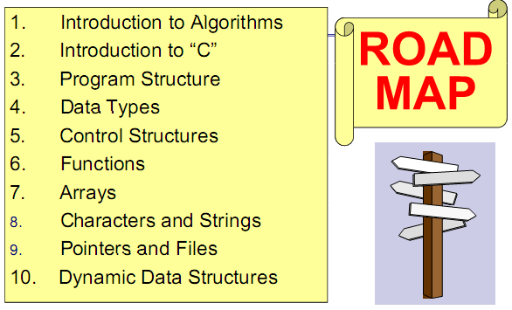
Slide <number>
Notes:
C language was standardized in 1989 by ANSI and then world wide by ISO. We call it standard C.
C++ is an object oriented programming language based on C.

Slide 7

1.4 Text Book
Slide <number>
Deitel and Deitel “C How to Program” ,7th Edition,
ISBN: 978-0-13-299044-8
© 2013
Notes:
C language was standardized in 1989 by ANSI and then world wide by ISO. We call it standard C.
C++ is an object oriented programming language based on C.

Slide 8
1.5 Labs for Programming Fundamentals
Slide <number>
The laboratory experiments for Programming Fundamentals are an integral part of the course
You cannot learn to program without actually writing programs and the laboratory experiments are intended to give you this practice
It is not possible to just turn up to the laboratory and expect to be able to complete the exercises – You have to prepare beforehand.

Slide 9
1.6 How to Succeed
Slide <number>
Put the effort in
Make good use of the available resources
Attend lectures and labs
Read books and online materials
Lot of practice
ASK!!! Lecturer and demonstrators
Aim to fully understand new concepts
Only the exercises are not enough!

Slide 10
1.7 How to Fail!
Slide <number>
Relax too much
Don’t assimilate material given in lectures
Absent labs
Don’t seek help
“Borrow” from “others”
  They can’t help in the exam or class tests!!!!

Slide 11
1.8 Ground Rules
Slide <number>
No mobile phones
Arrive on time!
If you do not understand a point, raise your hand and ask me to explain or contact during office hours
No disruption!!!! No Misconduct!!!!
REMEMBER: Your first priority must be your studies

Slide 12
Let's Start …
Slide <number>

